Slide 1
UX STRATEGY
Solent University Alumni Association (SUAA)

Slide 2
USER PERSONA
Name | Aiden Jimenez
Background | Aiden is a 20 years old graduate student from Solent University in Computer science. He has recently completed his graduation and is presently searching for jobs in Computer science sector. He is single child living with his parents in Southampton in a 2 bedroom flat. He is involved in some volunteer community work in his locality for his helping poor people.
Goals | Intends to land the best job in the Computer science sector Wants to analyze the website of Solent University alumni for some impressive job opportunities
Challenges | Not being able to determine the methods by which he would be able to save money
Motivations | Ensure he is able to create the best future for himself
User persona helps in understanding the typical user of the system
Helps in determining the main goals of the users while using the system
Persona helps in determining what could be done for improving the user experience of the users
Name | Franklin Jones
Background | Franklin is a 19 years old male who intends to pursue graduation in Architecture from Solent University. He is a single child, living with his father in a two-bedroom flat in Seattle. He has completed his secondary education from prestigious school in Seattle and intends to pursue further studies.
Goals | Intends to travel the world before he would be involved in the corporate world
Challenges | Not being able to determine whether it would be suitable to pursue further studies or get a job
Motivations | Provide the best quality life to his parents
Notes:
User persona is the profile which effectively represents the subgroup of the overall target audience. The user personas are mainly based on the real-life data as well as helps in reflecting the needs and wants of the overall target audience. The user personas are rather crucial because it helps in making the informed product decisions. It also helps in empathizing with the user needs and the user experience. The user persona being presented in the slide helps in understanding the typical users of the Solent University website and how the website is being presently used. The persona created in this report helped in understanding what users think and how would they perceive the new product being developed.

Slide 3

USER SCENARIO
User scenario is mainly describing how the user would be using the new system being developed
User scenario helps in understanding the situations in which the system would be used and benefits would be gained
User scenario helped in determining mindset of the users while using the new system
Notes:
The use of user scenario is being done in the report for determining how the users would be using the new system being developed. User scenarios are basically the detailed description of the users, commonly any persona, which helps in describing the realistic situations prevalent to design of the solutions. The user scenarios are being developed in this report for understanding how the Alumni website is being used by the users and what benefits are gained by the users.

Slide 4

USER GOALS
User goals are created for the Solent University Alumni website for understanding what are the needs of the users from the website
User goals helped in understanding how the users intends to use the Solent University website and complete their tasks easily.
Notes:
User goals are considered as the general descriptions of the end states which the users intends to reach. Significantly, it could be determined that the user goals must denote to the real-world end states, and they are not rather confined to the overall scope of website. The user goals being developed for the new Solent University Alumni website are:
As a user, I want to use the system for checking information about the past alumni of the University and view information about how the University has shaped future of students.
As a graduate student, I want to use the system for checking the opportunities and events being organized by the University for delivering better future of the students.
As a post-graduate student, I want to use the system for checking information about the seminars being conducted and invitations received for delivering speech in seminar.
As a user, I want to use the system for registering for receiving duplicate of degree certificate from the University.

Slide 5
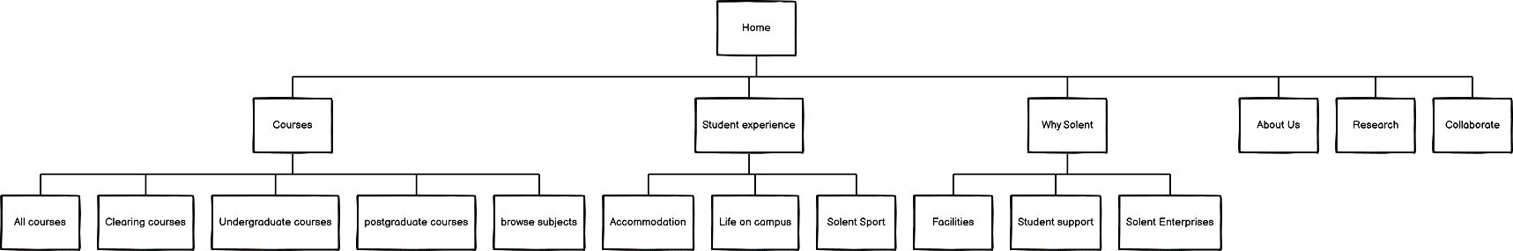
INFORMATION ARCHITECTURE
Information architecture of the new website is determining how the website is being structured and what information is being conveyed by the website
Solent University Alumni website is being segregated into proper pages within the navigation menu for simplifying the accessibility
Notes:
Information architecture could be determined as the document which offers the proper operational map for determining how the product is acting as well as functioning all the work for the users. It is mainly considered as the blueprint for the digital products as well as it helps in displaying the content, pages, behaviours and interactions for entire product. Information architecture of the new website is determining how the website is being structured and what information is being conveyed by the website. Solent University Alumni website is being segregated into proper pages within the navigation menu for simplifying the accessibility. The proper breakdown of the pages of the website into hierarchy structure helps in understanding the main pages and the subpages properly.

Slide 6
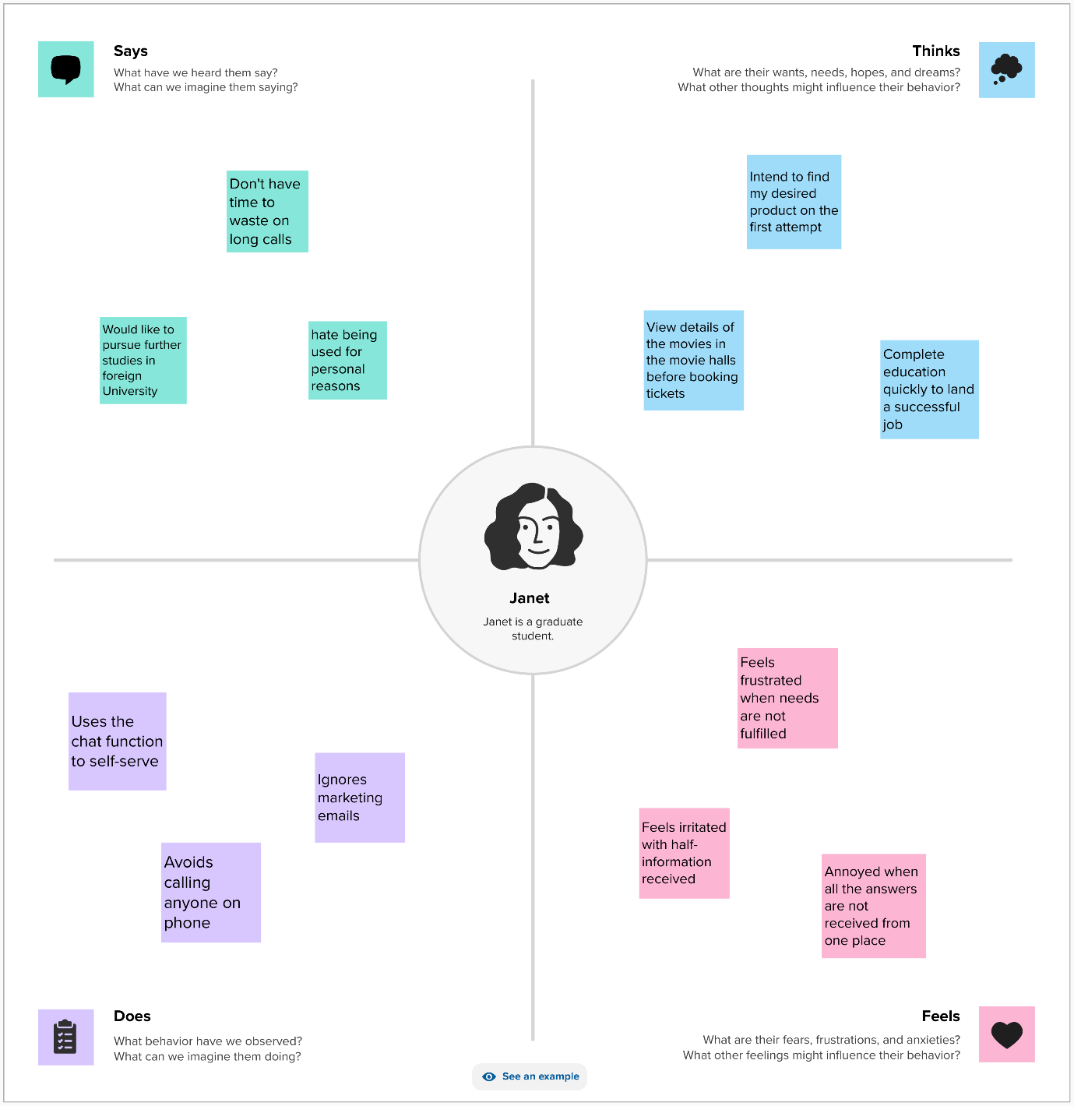
EMPATHY MAPPING
Empathy mapping is being done for Solent University Alumni website for determining how the typical users of the website behaves
Janet is the fictitious user being considered for creating the empathy map and determine how the users thinks while using the website
Notes:
Empathy map is mainly considered as the template which helps in organizing the behaviours and feelings of the users for creating the sense of the empathy among the users and the team. The empathy map is representing the principal user as well as helps the teams with understanding the motivations, experiences and the concerns of the users. The considered empathy map is being created for typical user of the website and how the user behaves in their normal life. The empathy mapping is being completed for capturing the mindset of the users and determine what are the needs of the users from the website.

Slide 7

USABILITY METRICS
Navigation
Data entry
Layout
Terminology
Comprehension
Feedback
Notes:
The navigation usability metric is being considered for determining whether the users are able to navigate through the various pages of the website easily without facing major issues and clear information is being viewed from the pages.
The data entry usability metric is being considered for determining whether the website allows the users to enter their data easily according to the pre-defined format and no other data is being accepted by the website.
The layout usability metric is being considered for determining whether the structure of the website is adapative according to the devices where it is being opened and whether all the information is being clearly displayed to the users.
The terminology usability metric would help in determining whether the appropriate terms and naming conventions are being followed in the website or not.
The comprehension usability metric would help in determining whether the users are able to understand all the instructions being presented on the website and complete their tasks without requiring major guidance about using the website.
The feedback usability metric would help in determining whether the website is providing accurate feedback for the tasks being completed by the users and whether the feedback is according to the expectations of the users while completing the tasks.

